Slide 1
TEI-encoding of classical Arabic linguistic terminology
Simona Olivieri
Humboldt Research Fellow
Freie Universität Berlin

Slide 2
Research project
TEI-encoding of classical Arabic grammatical sources
Digital collection of Arabic grammatical treatises

Slide 3
Corpus:
Classical Arabic gramm treatises
Methodology:
TEI-encoding
Output:
Digital collection & Dictionary of concepts

Slide 4
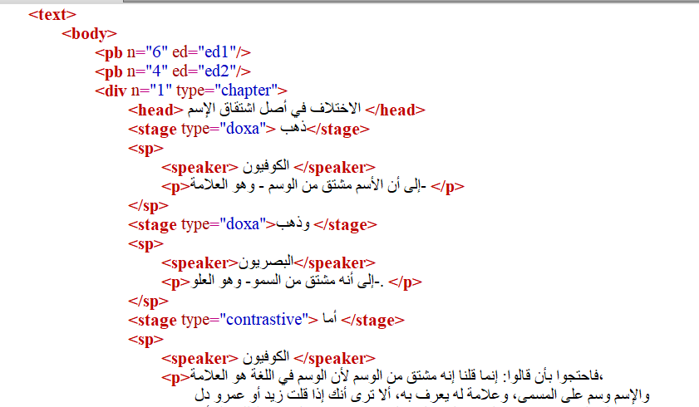

Slide 6
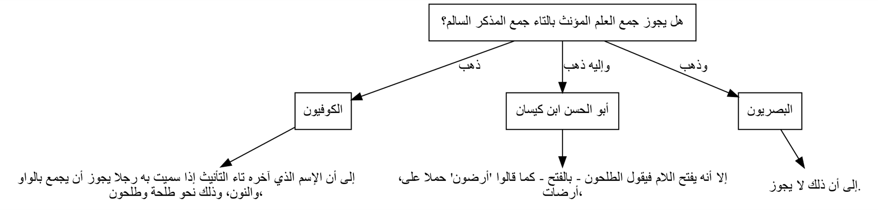

Slide 7
Linguistic terminology
Information/sources contained therein (outer sources, i.e. Qurāʾn)

Slide 8
Linguistic terminology
Information/sources contained therein (outer sources, i.e. Qurāʾn)

Slide 9
Kitāb Sībawayhi (8th century)
First grammatical treatise of Arabic
Terminology preserved in later traditions
Mark the linguistic terms by providing their translation and their occurrences

Slide 10
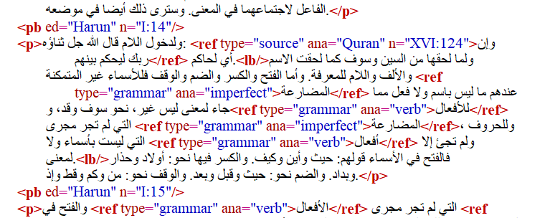

Slide 12
Expectations
More refined methods for the creation of my linguistic resources (i.e., dictionaries, taxonomies)
Better understanding of e-lexicography

Slide 13

Time’s Up!
Simona Olivieri
Humboldt Research Fellow
Freie Universität Berlin
fu-berlin.academia.edu/SimonaOlivieri

